Slide 1
No more Boomerang

Slide 2
TODAY WE ARE LEARNING TO
… analyse and interpret Oodgerie Noonuccal’S poem ‘NO MORE BOOMERANG’

Slide 3
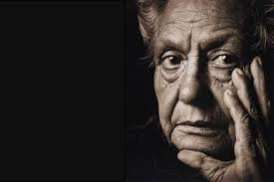
OODGEROO NOONUCCAL
Oodgeroo of the Noonuccal, known until 1988 as Kath Walker, was an Australian poet, political activist, artist and educator. She was also a campaigner for Aboriginal rights.^{[1]} Oodgeroo was best known for her poetry, and was the first Aboriginal Australian to publish a book of verse.^{[2]}
In her youth she worked as domestic servant because she couldn’t get other jobs. In 1941 she enlisted in the Australian Women’s Army Service (AWAS), earning promotion to corporal. She had to leave the army after losing her hearing and trained in secretarial and bookkeeping skills at Brisbane Commercial College under the army’s rehabilitation scheme.
Her first poetry collection was published in 1964 as We Are Going . The work was an immediate commercial success, selling more than ten thousand copies.
In 1988 she adopted a traditional name: Oodgeroo (meaning "paperbark tree") Noonuccal (her tribe's name)

Slide 4
Protest poem
Oodgerie was known for her poems which were seen as protest poems about the treatment of Indigenous people in Australia.
What do you think were some things she was protesting?

Slide 5
In the beginning…
The first Australian Settlers arrived in Australia in 1788.
A British sailor called Captain Cook had arrived in Australia 18 years earlier and it had been decided that the country was “Terra Nullius” - literally “Land Empty.”
In other words, the British could claim the land and send whoever they liked there.

Slide 6
In the beginning…
The “First” Australians would be the following people:
Embarked at Portsmouth
* Officials and passengers: 15
* Ships' crews: 323
* Marines: 247
* Marines wives and children: 46
* Convicts (males): 582
* Convicts (females): 193
* Convicts' children: 14
* Total embarked: 1420

Slide 7
In the beginning…
The “First” Australians would be the following people:
Landed at Port Jackson
* Officials and passengers: 14
* Ships' crews: 306
* Marines: 245
* Marines wives and children: 54
* Convicts (males): 543
* Convicts (females): 189
* Convicts' children: 22
* Total landed: 1373

Slide 8
In the beginning…
Embarked at Portsmouth
* Officials and passengers: 15
* Ships' crews: 323
* Marines: 247
* Marines wives and children: 46
* Convicts (males): 582
* Convicts (females): 193
* Convicts' children: 14
* Total embarked: 1420
The “First” Australians would be the following people:
Landed at Port Jackson
* Officials and passengers: 14
* Ships' crews: 306
* Marines: 245
* Marines wives and children: 54
* Convicts (males): 543
* Convicts (females): 189
* Convicts' children: 22
* Total landed: 1373
During the voyage there were 22 births (13 males, 9 females), while 69 people either died, were discharged, or deserted (61 males and 8 females).

Slide 9
In the beginning…
Of course, as it was, there were already people living in Australia.
The various tribes of the Aboriginal People of Australia had been living in the country for about 40,000 to 50,000 years. Which is quite a while.
You can imagine them not being too happy about a bunch of pale strangers turning up and taking their land.
This picture, an engraving from the 1800s shows the original Australians kicking up a fuss as Captain Cook arrives.

Slide 10
In the beginning…
What actually happened was a bit different.
A pair of Aboriginal Men came down to meet Cook’s men as they first set foot in Australia. The British offered gifts, which the Australians ignored. To be fair, a few trinkets probably didn’t seem that important at the time.
The British were worried that they hadn’t taken the gifts and fired a musket was fired over the Aboringal’s heads, which wounded the older man slightly, and he ran towards the huts.

Slide 11
In the beginning…
He came back with other men and threw spears at Cook's men, although they did no harm. They were chased off after two more rounds were fired. The adults left, but Cook found several Aboriginal children in the huts, and left some beads with them as a gesture of friendship.
Not a great start, really.

Slide 12
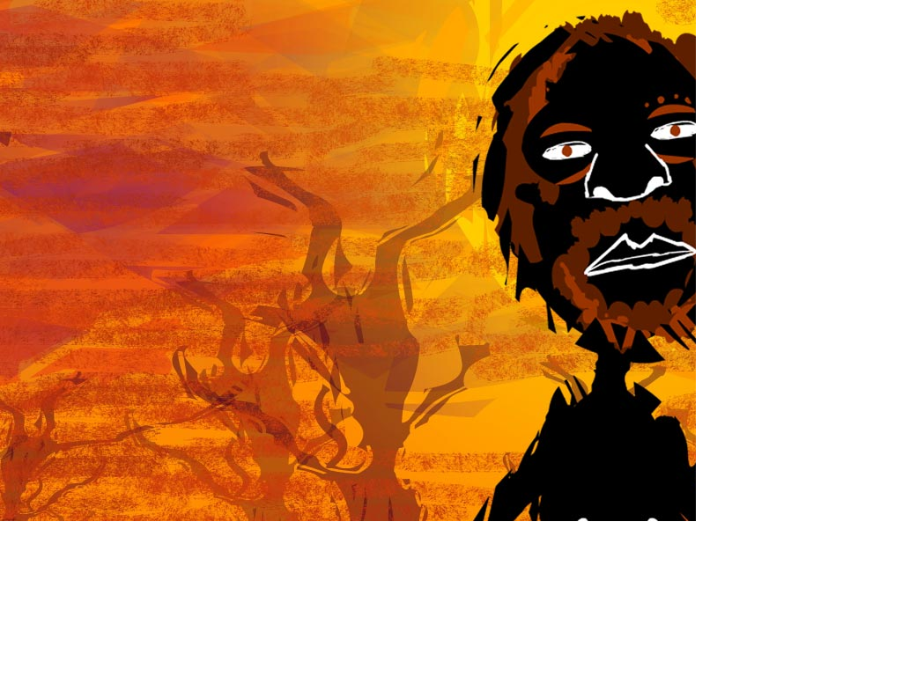
What Happened After We Got Here
The Story of Aboriginal Australia

Slide 13
What Happened After We Got Here
The larger communities were worst hit, with vast numbers of Aborigines dying. Some tribes were practically wiped out.

Slide 14
What Happened After We Got Here
The second consequence of British settlement was appropriation of land and water resources. The settlers took the view that Indigenous Australians were nomads with no concept of land ownership, who could be driven off land wanted for farming or grazing and who would be just as happy somewhere else. In fact the loss of traditional lands, food sources and water resources was usually fatal, particularly to communities already weakened by disease.

Slide 15
What Happened After We Got Here
Also, Indigenous Australians groups had a deep spiritual and cultural connection to the land. When they were forced out, cultural and spiritual practices necessary to the cohesion and well-being of the group could not be maintained. It would be like not being allowed to go meet your friends in the park, or in Churches, or restaurants. With nowhere to meet each other for a chat or worship, societies fell apart.

Slide 16
What Happened After We Got Here
Unlike in New Zealand, no treaty was ever entered into with the indigenous peoples entitling the Europeans to land ownership. The Europeans just took it, claiming the Australians weren’t really using it properly.

Slide 17
What Happened After We Got Here
Indigenous Australians weren’t used to the alcohol, opium and tobacco the settlers brought and had no tolerance. European society had used these things for hundreds of years and had “grown up” with them. Giving them to Aborigines was like giving them to children.
Substance abuse has remained a chronic problem for indigenous communities ever since.

Slide 18

Background information
Dispossession and Government Control - Aboriginal History
https://www.youtube.com/watch?v=vOExa-04Y2k
Aboriginal people respond to Australia Day
https://www.youtube.com/watch?v=G8czHlPYXew

Slide 19
No more boomerang
No more spear;
Now alll civilized-
Colour bar and beer.
No more corroboree,
Gay dance and din.
Now we got movies,
And pay to go in.
No more sharing
What the hunter brings.
Now we work for money,
Then pay it back for things.
Now we track bosses
To catch a few bob,
Now we go walkabout
On bus to the job.
One time naked,
Who never knew shame;
Now we put clothes on
To hide whatsaname.
No more gunya,
Now bungalow,
Paid by hire purchase
In twenty year or so.
Lay down the stone axe,
Take up the steel,
And work like a nigger
For a white man meal.
No more firesticks
That made the whites scoff.
Now all electric,
And no better off.
Bunyip he finish,
Now got instead
White fella Bunyip,
Call him Red.
Abstract picture now-
What they coming at?
Cripes, in our caves we
Did better than that.
Black hunted wallaby,
White hunt dollar;
White fella witch-doctor
Wear dog-collar.
No more message-stick;
Lubras and lads
Got television now.
Mostly ads.
Lay down the woomera,
Lay down the waddy.
Now we got atom-bomb,
End everybody.

Slide 20
Definitions
Corroboree-an Australian Aboriginal dance ceremony which may take the form of a sacred ritual or an informal gathering.
Walkabout-a journey (originally on foot) undertaken by an Australian Aboriginal in order to live in the traditional manner.
Gunya-an aboriginal hut or shelter
Bunyip-a mythical amphibious monster said to inhabit inland waterways.
Lubra-an Aboriginal woman.
Woomera-an Aboriginal stick used to throw a spear more forcibly.
Waddy-an Australian Aboriginal's war club.

Slide 21

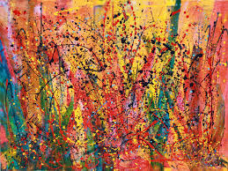
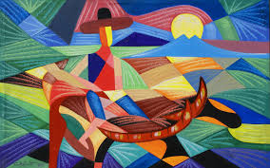
Abstract art
Abstract art uses a visual language of shape, form, color and line to create a composition which may exist with a degree of independence from visual references in the world.[

Slide 22
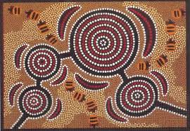
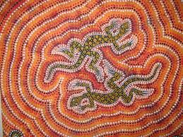
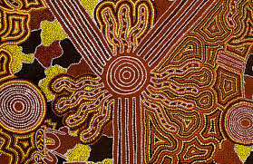
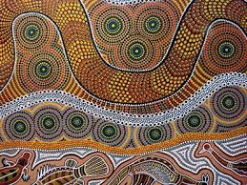
Aboriginal Art

Slide 23

White fella witch-doctor
Wear dog-collar.

Slide 24
Activities
What is the poem is about? Write your own response.

Slide 25
Images
Compare the features of the traditional Aboriginal way of life with that of the
technologically based civilised way. How are family life, housing, the arts and human interaction affected?
Traditional Aboriginal | Contemporary ‘civilised’ white

Slide 26
Interpreting the poem
In contrasting the two lifestyles Oodgeroo makes it very clear to the reader which lifestyle she believes is preferable. Find words or lines in the poem that show this.

Slide 27
Stanzas
Oodgeroo has used a simple stanza form to write her poem. Examine the
patterns in each stanza. Which words rhyme? Why do you think the poet has
rhymed words in this way? Discuss how the past establishes the contrasting aspects in each stanza.

Slide 28
Poetic images
There are some very powerful images in this poem. Some of these are listed below. Next to each one write an explanation of what you think Oodgeroo means by this image.

Slide 29
Poetic images-what does each of these mean
To hide whatsaname
Higher purchase
Work like a nigger
White man meal
Abstract picture
White hunt dollar
White fella witch-doctor/wear dog-collar
End everybody

Slide 31
To write a poetry analysis of No More Boomerang

Slide 32
Introduction: What is the poet’s message?
❏ Introduction which states the main idea of the poem and includes the poet’s name and title of poem
The poem (title) written by (poet’s name) is about (main ideas/themes/issues)…

Slide 33
Introduction: What is the poet’s message?
❏ One clear idea that the whole poem is about and how the poet conveys this idea
The main idea that the poet explores is…. This is conveyed through…. (which poetic techniques)

Slide 34
Introduction: What is the poet’s message?
❏ Discussion of the poet’s message about this idea
The poet’s message is …

Slide 35
Paragraph 1: Poetic technique 1 (each paragraph to discuss a different technique)
❏ Discussion of poem includes an understanding of the way in which a poetic technique has been used in the poem:
Simile, Alliteration, Rhyme, Rhythm, Personification, Metaphor, Onomatopoeia, Repetition

Slide 36
Paragraph 1: Poetic technique 1 (each paragraph to discuss a different technique)
❏ How the technique is used to show ideas
An important technique in the poem is…which illustrates/evokes/symbolises…
OR
Throughout the poem there is the technique of…

Slide 37
Paragraph 1: Poetic technique 1 (each paragraph to discuss a different technique)
❏ How technique engages the reader
One effect of the technique of…is to…Another effect of it is to…
OR
Through using this technique, the poem…
OR
By using the technique of…,the poet..

Slide 38
Paragraph 1: Poetic technique 1 (each paragraph to discuss a different technique)
❏ Paragraph focusses on a main idea or technique and includes a number of examples, an explanation about each example and a concluding sentence which links the examples.
The words “…” are an example of…which…
OR
An instance of…is…
OR
The technique of…does two things. Firstly, it…Secondly, it also….

