Slide 1
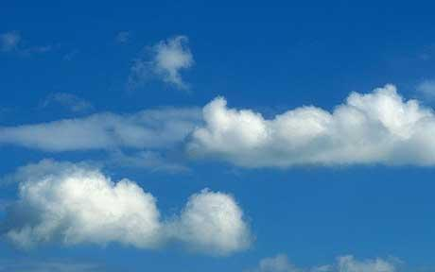
Out Of The Blue
by Simon Armitage

Slide 2
Today we are learning to …
… analyse and interpret an extract from Simon Armitage’s poem ‘Out of the ‘Blue’

Slide 3
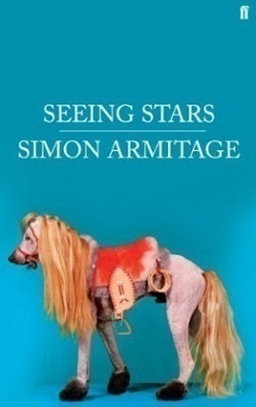
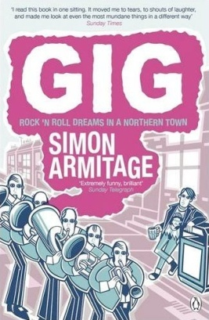
Simon Armitage
Born 1963, West Yorkshire
Studied Geography at Portsmouth University
Has published 17 collections of poetry, written fiction and non-fiction books, written plays and songs for theatre and radio, has written for and presented TV shows / documentaries
Has won LOADS of awards
Awarded CBE in 2010 for services to poetry
In a band called the Scaremongers - http://www.thescaremongers.com/

Slide 4
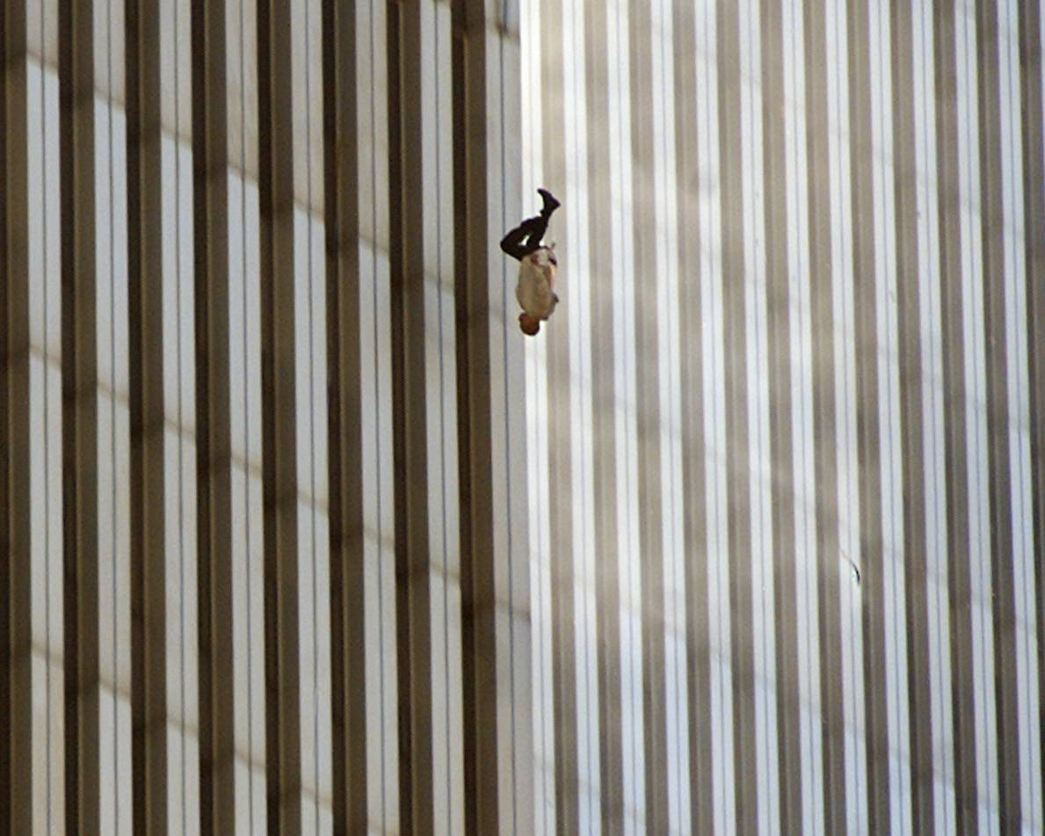
What’s this picture? Why is it controversial?

Slide 5
The Falling Man photograph
The Falling Man is a photograph taken by photographer Richard Drew, of a man falling from the North Tower of the World Trade Centre at 9:41:15 a.m. during the September 11 attacks in New York. The man’s identity is uncertain but is thought to be Jonathan Briley, a top-floor restaurant worker who was trapped on an upper floor – one of about 200 people who either fell as they searched for safety or jumped to escape the fire and smoke; there was no time to recover or identify those who were forced out of the buildings before the towers collapsed.
The New York City medical examiner's office stated that it does not classify the people who fell to their deaths on September 11 as "jumpers": "A 'jumper' is somebody who goes to the office in the morning knowing that they will commit suicide... These people were forced out by the smoke and flames or blown out."

Slide 6
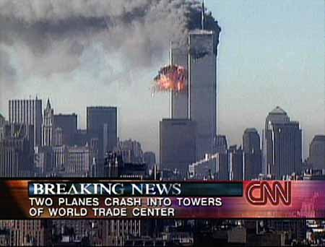

Slide 7
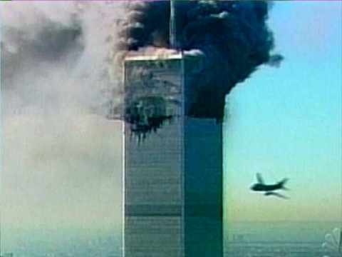

Slide 8
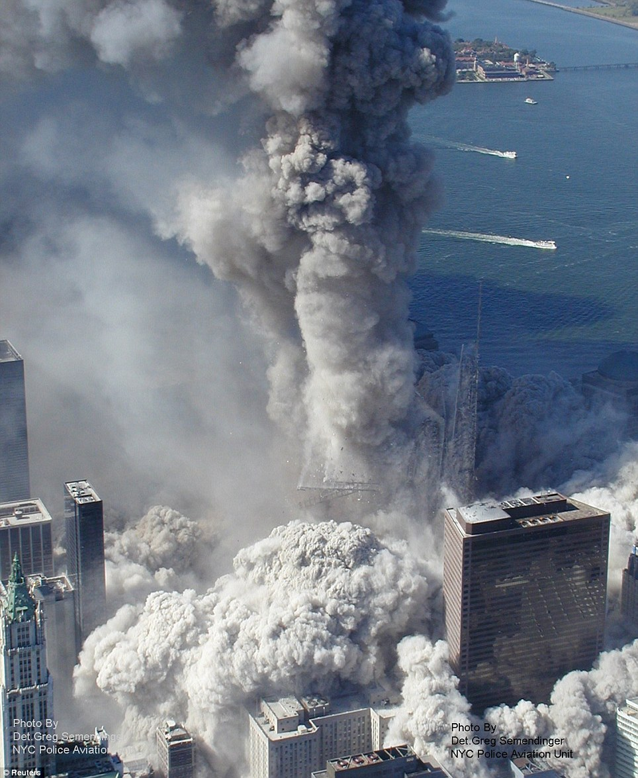

Slide 9
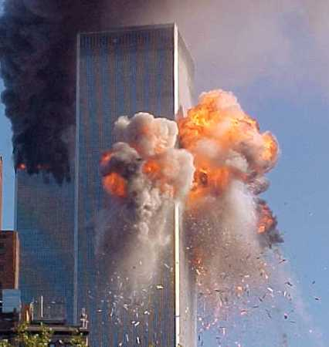

Slide 10
Background contextual research
Watch a documentary called ‘The Falling Man’ here: http://www.youtube.com/watch?v=eo6bIb_yiKs&list=PLFD9D40CEDBEE7777
Watch the Fox News live footage of the Twin Towers attacks here: http://www.youtube.com/watch?v=LhqLh_c0NL4

Slide 11
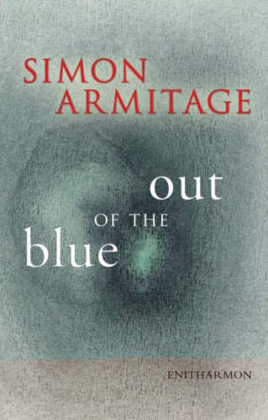
Background to the poem
Poem taken from Armitage’s 2008 anthology of the same name.
All the poems in this anthology are a response to three separate conflicts, all of which have changed the world we live in.
This poem is told from the point of view of an English trader working in the North Tower of the World Trade Centre.
The poem-film was commissioned by Channel 5 and broadcast five years after the 9/11 attacks on America.

Slide 12
________ have picked me out.
Through a distant shot of a building ________
________ have noticed now
that a white cotton shirt is ________, ________.
In fact ________ am _________, __________.
________ in the clouds, but ________, _________.
Does anyone see
a ________worth saving?
So when will ________come?
Do you think you are ___________, __________
a man shaking crumbs
or pegging out ________?
I am ________ and ________.
The ________behind me is ________, _________,
but the white of surrender is not yet _________.
I am not at the point of leaving, _________.
A ________goes by.
The depth is appalling. ________
that others like me
should be wind-milling, ________, spiralling, _________.
Are your eyes __________,
__________
that here in the gills
I am still ___________.
But tiring, _______.
Sirens below are ________, firing.
My arm is numb and my nerves are _________.
Do you see me, my love. I am _________, _________.
Try to fill the gaps. If you get stuck, you might refer to the Wordle cloud to help you.
You have 9 minutes.
Your objective is not to get it right, but to think logically about the type of word choices considering the context of the poem.
Perhaps think about poetic techniques that might be used.

Slide 13
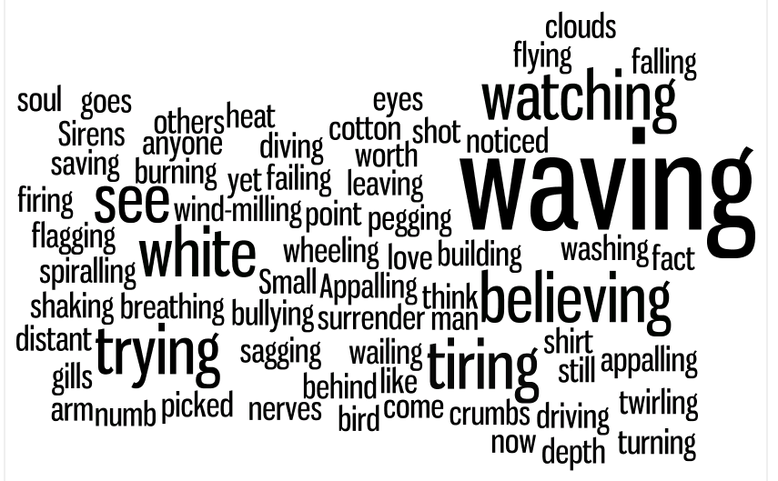
Wordle cloud

Slide 14
You have picked me out.
Through a distant shot of a building burning
you have noticed now
that a white cotton shirt is twirling, turning.
In fact I am waving, waving.
Small in the clouds, but waving, waving.
Does anyone see
a soul worth saving?
So when will you come?
Do you think you are watching, watching
a man shaking crumbs
or pegging out washing?
I am trying and trying.
The heat behind me is bullying, driving,
but the white of surrender is not yet flying.
I am not at the point of leaving, diving.
A bird goes by.
The depth is appalling. Appalling
that others like me
should be wind-milling, wheeling, spiralling, falling.
Are your eyes believing,
believing
that here in the gills
I am still breathing.
But tiring, tiring.
Sirens below are wailing, firing.
My arm is numb and my nerves are sagging.
Do you see me, my love. I am failing, flagging.
Extract from
Out of the Blue
CLICK HERE TO PLAY

Slide 15
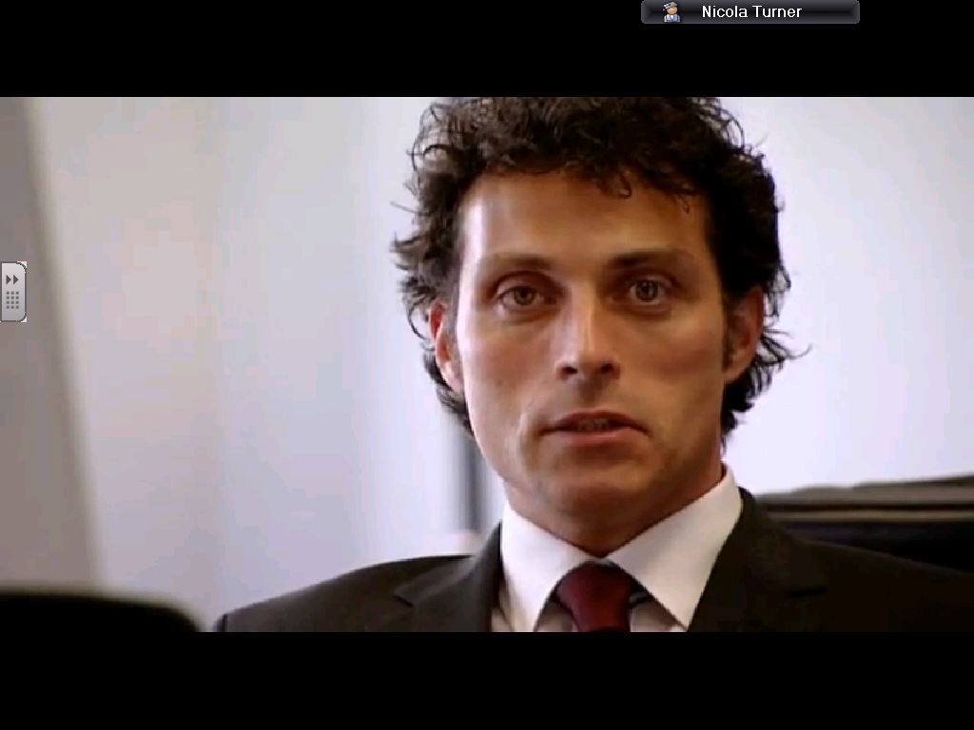
Watch the video of the whole poem. How does it add to your understanding of the extract?
PLAY

Slide 16
Complete activities in booklet
What is significant about the narrator waving a white shirt?
What does the narrator describe he can see and how does he react?
What effect does the poet have addressing you as a reader directly?
The narrator feels insignificant. Why?
There are 2 meanings of 'flagging'. Why does Simon Armitage use this as the last word of the poem?

Slide 17
Who is the speaker? Who is s/he speaking to?
Pronoun 'you' draws reader's focus
Speaker is just faint blur – watching on TV (‘shot’)? Too far to help.
You have picked me out.
Through a distant shot of a building burning
you have noticed now
that a white cotton shirt is twirling, turning.
White cotton shirt is the 'uniform' of the average office worker – could be anyone.
White = surrender
Alliteration and rhyme combine to emphasise last 2 words

Slide 18
Waving for help – desperation emphasised by repetition
Insignificance? Like a bird?
In fact I am waving, waving.
Small in the clouds, but waving, waving.
Does anyone see
a soul worth saving?
Desperation – rhetorical question – a please for help?
Juxtaposition of horror of situation with waving which seems friendly – reminds us of the ‘Not Waving But Drowning’ poem?
Alliteration emphasises the speaker’s sense of mortality – the end is coming – reference to Judgement Day?

Slide 19
“Watching” – repetition – we are all ghoulishly watching – horrified from the ground or on TV but it’s an impossible situation as we can’t help. Think how we feel as readers when he questions us this way.
A direct question – a desperate plea for help
And when will you come?
Do you think you are watching, watching
a man shaking crumbs
or pegging out washing?
Juxtaposition of horror of someone fighting for their life with ordinary actions. Sense of fear and panic? WHY won’t you help?

Slide 20
Repetition of 'trying' and regular, repetitive end-rhyme here adds further emphasis to this sense of impending doom and anxiety.
I am trying and trying.
The heat behind me is bullying, driving,
but the white of surrender is not yet flying.
I am not at the point of leaving, diving.
The heat of the fires behind him are 'bullying' him (personification) towards death, 'driving' him, although he is not yet ready to surrender. We sense his end is close.

Slide 21
A very strange observation – absurd to notice this? Emphasises how high he is? Emphasises his fate to fall not fly.
He could be any one of us and that is the point
A bird goes by.
The depth is appalling. Appalling
that others like me
should be wind-milling, wheeling, spiralling, falling.
Feminine rhyme: a rhyme where one or more unstressed syllables follow a stressed one
Appalling, wind-milling, wheeling, spiralling, falling – the repetition of –ing draws attention to the verbs
Look at the similarities in the structure of the first 5 stanzas:
- rhyme
rhythm
enjambement
repetition
line lengths
Creates a falling rhythm (like in Light Brigade) – to emphasise the fate of the speaker.

Slide 22
Are your eyes believing,
believing
that here in the gills
I am still breathing.
Every lines uses enjambment: the sentences always DROP onto the next line – highlights the fate of the speaker.
Layout – highlights a drop too

Slide 23
Structure of stanza changes here to end-stopped lines and rhyming couplets.
End has come. Simple statements indicate acceptance of death. Full stops = endings
But tiring, tiring.
Sirens below are wailing, firing.
My arm is numb and my nerves are sagging.
Do you see me, my love. I am failing, flagging.
Look how the verbs have changed from showing the speaker as active to slow and sluggish. Symbolises the fight to stay alive is going/gone.
Drama and anxiety via ‘narrative focus’ on the poem from the general to the particular - from the big picture to the fine details - the man hanging from the window – like a film/photo zoom in (Falling Man photo? TV news?)

Slide 24
To write a poetry analysis of out of the blue

Slide 25
Introduction: What is the poet’s message?
❏ Introduction which states the main idea of the poem and includes the poet’s name and title of poem
The poem (title) written by (poet’s name) is about (main ideas/themes/issues)…

Slide 26
Introduction: What is the poet’s message?
❏ One clear idea that the whole poem is about and how the poet conveys this idea
The main idea that the poet explores is…. This is conveyed through…. (which poetic techniques)

Slide 27
Introduction: What is the poet’s message?
❏ Discussion of the poet’s message about this idea
The poet’s message is …

Slide 28
Paragraph 1: Poetic technique 1 (each paragraph to discuss a different technique)
❏ Discussion of poem includes an understanding of the way in which a poetic technique has been used in the poem:
Simile, Alliteration, Rhyme, Rhythm, Personification, Metaphor, Onomatopoeia, Repetition

Slide 29
Paragraph 1: Poetic technique 1 (each paragraph to discuss a different technique)
❏ How the technique is used to show ideas
An important technique in the poem is…which illustrates/evokes/symbolises…
OR
Throughout the poem there is the technique of…

Slide 30
Paragraph 1: Poetic technique 1 (each paragraph to discuss a different technique)
❏ How technique engages the reader
One effect of the technique of…is to…Another effect of it is to…
OR
Through using this technique, the poem…
OR
By using the technique of…,the poet..

Slide 31
Paragraph 1: Poetic technique 1 (each paragraph to discuss a different technique)
❏ Paragraph focusses on a main idea or technique and includes a number of examples, an explanation about each example and a concluding sentence which links the examples.
The words “…” are an example of…which…
OR
An instance of…is…
OR
The technique of…does two things. Firstly, it…Secondly, it also….

